Slide 1

Gender Pay

Slide 2
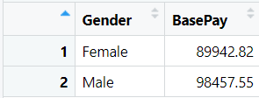
Gender and Average Base Pay

Slide 3
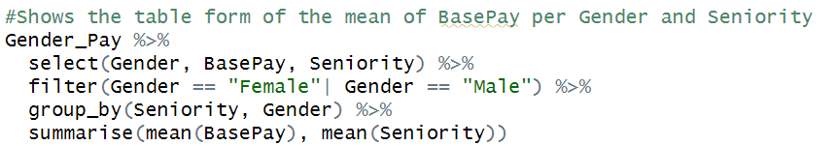
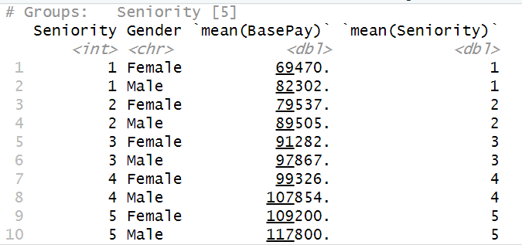
Seniority, Base pay and Gender

Slide 4
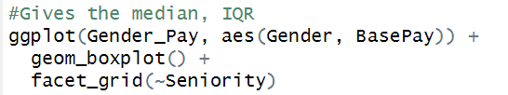
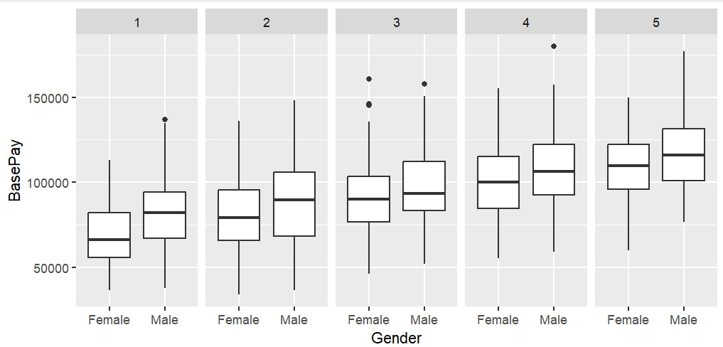
Seniority, Base pay and Gender

Slide 5
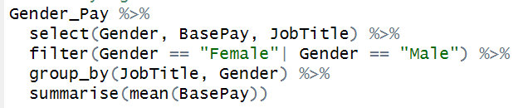
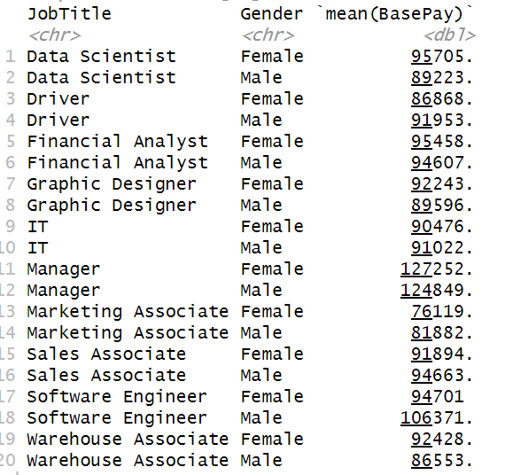
Job title and base pay per gender

Slide 6
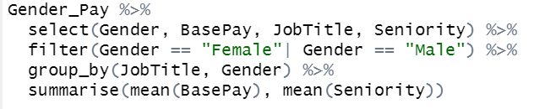
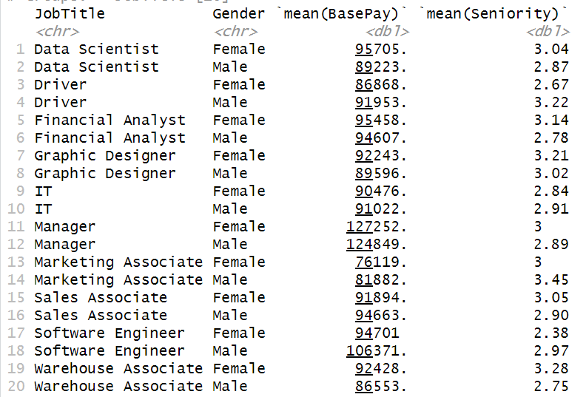
…And adding seniority

Slide 7
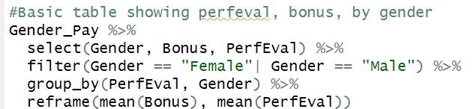
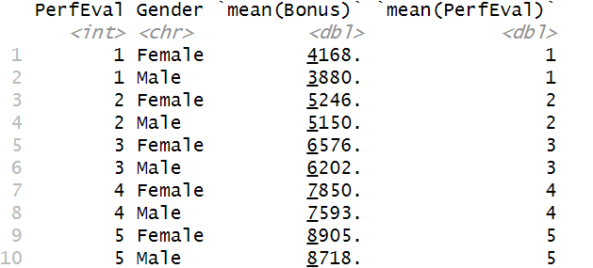
Performance evaluation and bonus per gender

Slide 8
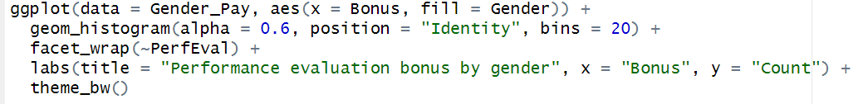
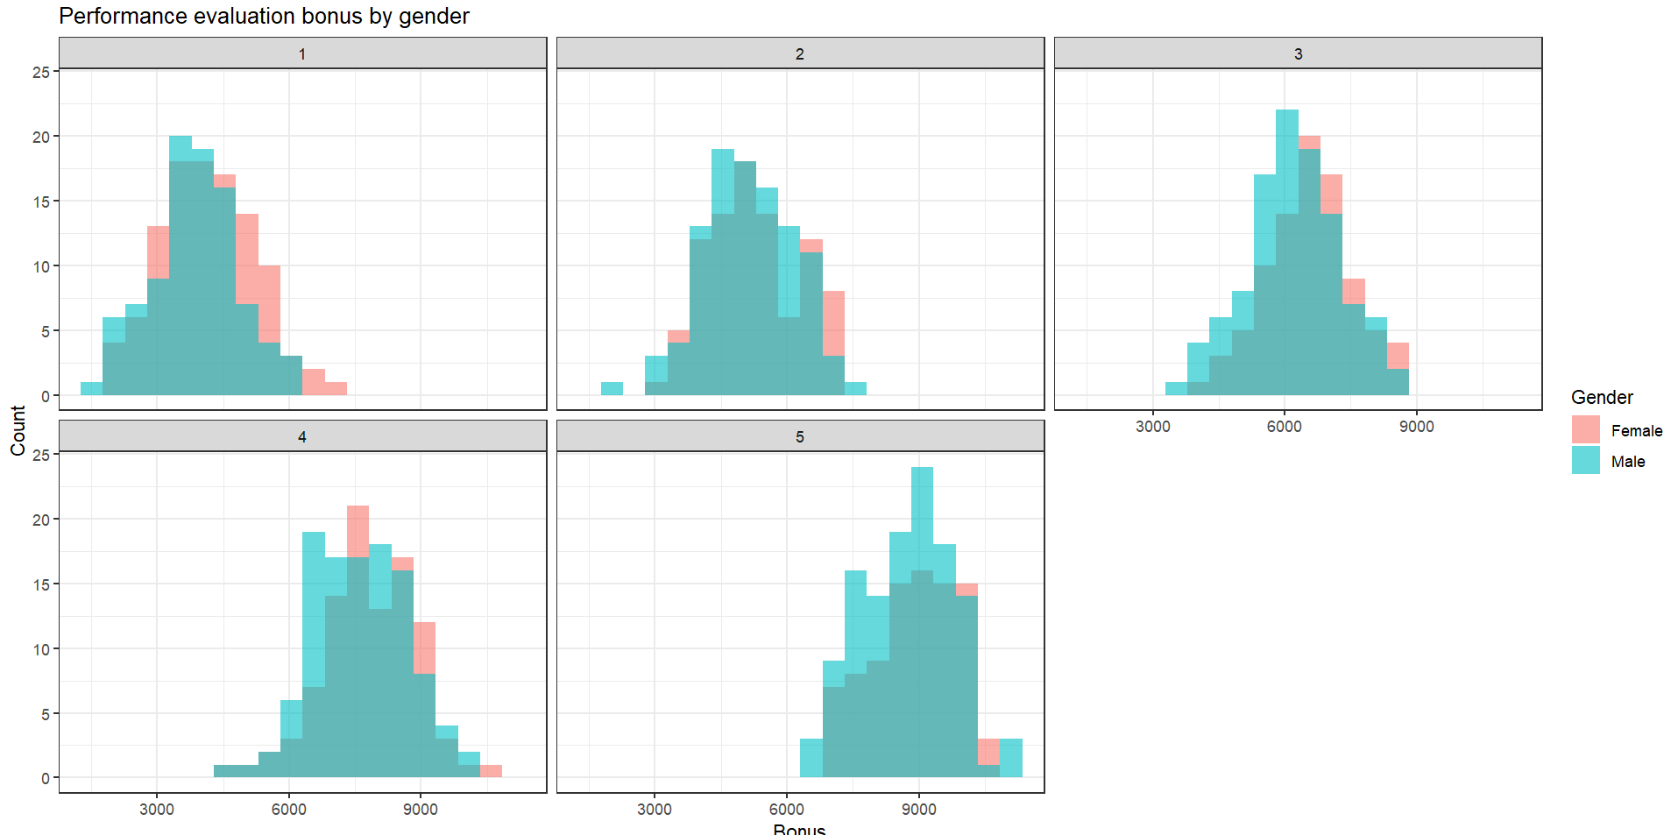

Slide 9
Take home messages:
There is a pay gap between gender, however, there are many factors that contribute to it
Job type, performance, time and expertise are just few examples

Slide 10
Thank you
Any questions?
Catrina & Alessia☺

